Slide 1
Force sensing at the end effector
Rigid inner sleeve
3D Hall Effects Sensor
Elastomer
Rigid outer sleeve
Neodymium
Magnet

Slide 2
Force sensing at the end effector
https://www.aluminiumwarehouse.co.uk/6-mm-x-1-mm-aluminium-round-tube
5/8”
6mm
9.3mm
4mm
https://www.aluminiumwarehouse.co.uk/5-8-in-x-10-swg-aluminium-round-tube
Also need conrod (see SW 3/8X16swg)

Slide 3
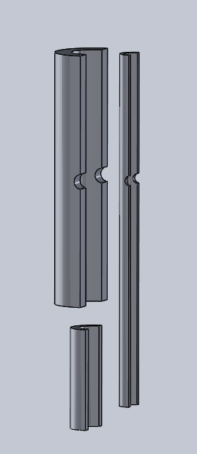
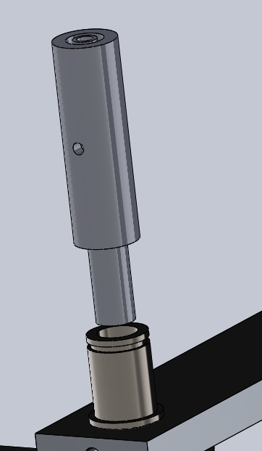

Slide 4
Currently only got 2mm
Ish for space.
Maybe for testing I
Could manufacture
Extended poles?
Torque sensing at the joints

Slide 5
Email Dom the specs for simulation stuff

